Slide 1
Chapter 2 Application Layer
Gandeva Bayu Satrya (GBS)
gandeva.bayu.s@gmail.com
TELKOM INSTITUTE of TECHNOLOGY

Slide 2


Agenda
Chapter 2. Application Layer
2.1 Principle of Net Application
2.2 Web & HTTP
2.3 FTP
2.4 E-mail in The Internet
2.5 DNS
2.6 Peer-to-peer Application

Slide 3
Introduction
Internet Application
=====================================
1970s and 1980s : the classic text-based applications
mid-1990s : the World Wide Web, encompassing Web surfing, search, and electronic commerce, instant messaging, P2P file sharing.
Since 2000 : voice and video applications
this same period : highly engaging multi-player online games, and new generation of social networking applications
Next…???

Slide 4
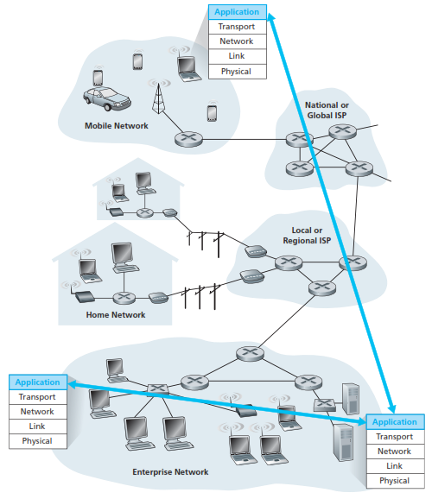
2.1. Principle of Net. App.

Slide 5
2.1. Principle of Net. App.
2.1.1. Network Application Architecture
Client-Server
there is an always-on host, called the server, which services requests from many other hosts, called clients.
Peer-to-Peer (P2P)
there is minimal (or no) reliance on dedicated servers in data centers.
Hybrid of client-server and P2P
combining both client-server and P2P elements. For example, for many instant messaging applications.

Slide 6
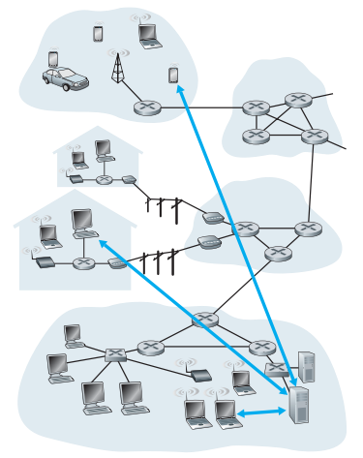
a. Client-Server
server:
always-on host
permanent IP address
server farms for scaling
clients:
communicate with server
may be intermittently connected
may have dynamic IP addresses
do not communicate directly with each other

Slide 7
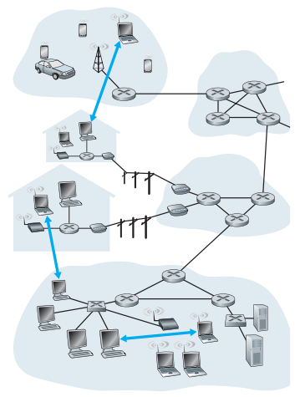
b. Peer-to-Peer
no always-on server
arbitrary end systems directly communicate
peers are intermittently connected and change IP addresses
Highly scalable but difficult to manage

Slide 8
c. Hybrid
Skype
voice-over-IP P2P application
centralized server: finding address of remote party:
client-client connection: direct (not through server)
Instant messaging
chatting between two users is P2P
centralized service: client presence detection/location
user registers its IP address with central server when it comes online
user contacts central server to find IP addresses of buddies

Slide 9
2.1. Principle of Net. App.
2.1.2 Processes Communicating
processes a program that is running within an end system.
within same host, two processes communicate using inter-process communication (defined by OS).
processes in different hosts communicate by exchanging messages.
Client process : process that initiates communication
Server process : process that waits to be contacted

Slide 10
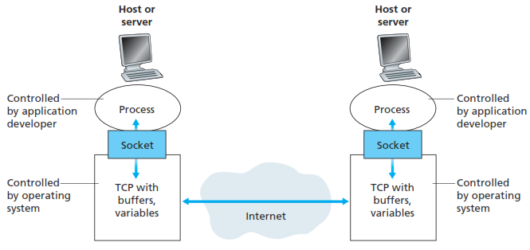
2.1. Principle of Net. App.
2.1.2 Processes Communicating
A process sends messages into, and receives messages from, the network through a software interface called a socket.

Slide 11
2.1. Principle of Net. App.
2.1.2 Processes Communicating
to receive messages, process must have identifier
host device has unique 32-bit IP address
Q: does IP address of host on which process runs suffice for identifying the process?
identifier includes both IP address and port numbers associated with process on host. (wait… Chapter 3.)
Example port numbers:
HTTP server: 80, Mail server: 25, etc… (Q: HTTPS…???)
HTTP message to www.telkomuniversity.ac.id web server:
IP address: 222.124.204.206
Port number: 80
Notes:
Q = Question
HTTP : 80
HTTPS : 443
FTP : 20/21 data transfer and control
SMTP : 25
POP : 110
TELNET : 23
SSH : 22

Slide 12
2.1. Principle of Net. App.
2.1.3 Transport Services Available to Applications
What are the services that a transport-layer protocol can offer to applications invoking it?
We can broadly classify the possible services along four dimensions:
Reliable data transfer : guarantee and loss-tolerant
Throughput : specified rate (bandwidth) : bandwidth-sensitive app, and elastic app
Timing : delay sensitive (RTS and nRTS)
Security : encrypt all data (CIA)
Notes:
Real Time System
Non Real Time System
Confidentiality, Integrity, and Availablelity

Slide 13
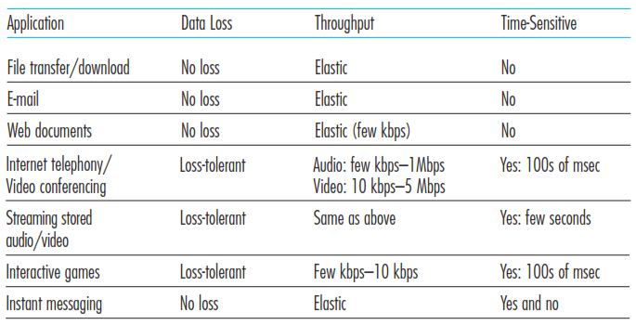
2.1. Principle of Net. App.
2.1.4 Transport Services Provided by the Internet
Requirements of selected network applications
Notes:
There is TCP and UDP….
Wait… in Chapter 3….

Slide 14
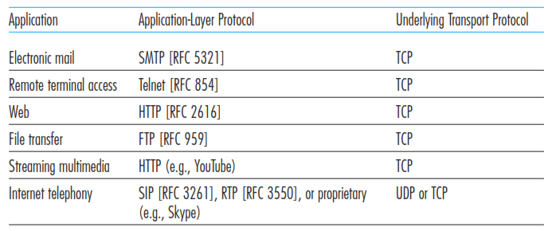
2.1. Principle of Net. App.
2.1.4 Transport Services Provided by the Internet
Popular Internet Application
Notes:
There is TCP and UDP….
Wait… in Chapter 3….

Slide 15
Agenda
Chapter 2. Application Layer
2.1 Principle of Net Application
2.2 Web & HTTP
2.3 FTP
2.4 E-mail in The Internet
2.5 DNS
2.6 Peer-to-peer Application

Slide 16
2.2. Web & HTTP
Web page consists of objects
Object can be HTML file, JPEG image, Java applet, audio file,…
Web page consists of base HTML-file which includes several referenced objects
Each object is addressable by a URL
Example URL :
www.telkomuniversity.ac.id/

Slide 17
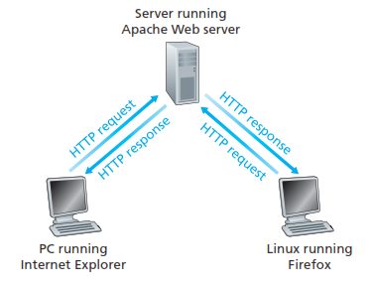
2.2. Web & HTTP
2.2.1 Overview of HTTP
HTTP: hypertext transfer protocol
Web’s application layer protocol
client/server model
client: browser that requests, receives, “displays” Web objects
server: Web server sends objects in response to requests

Slide 18
2.2. Web & HTTP
2.2.2 Non-Persistent and Persistent Connections
NonPersistent | Persistent
At most one object is sent over a TCP connection. | Multiple objects can be sent over single TCP connection between client and server.
requires 2 RTTs per object | as little as one RTT for all the referenced objects
OS overhead for each TCP connection | subsequent HTTP messages between same client/server sent over open connection
browsers often open parallel TCP connections to fetch referenced objects | client sends requests as soon as it encounters a referenced object

Slide 19
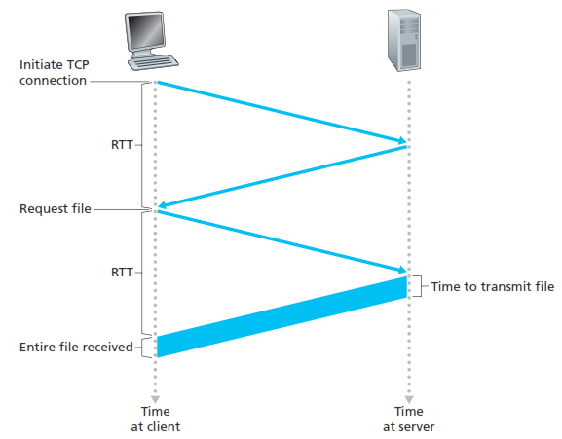
2.2. Web & HTTP
2.2.2 Non-Persistent and Persistent Connections
Notes:
we define the round-trip time (RTT), which is the time it takes for a small packet to travel from client to server and then back to the client.
The RTT includes packet-propagation delays, packet queuing delays in intermediate routers and switches, and packet-processing delays.

Slide 20
2.2. Web & HTTP
2.2.3 HTTP Message Format
The HTTP specifications [RFC 1945; RFC 2616]
There are two types of HTTP messages, request messages and response messages.
HTTP request message: ASCII (human-readable format)
request line
(GET, POST,
HEAD commands)
GET /somedir/page.html HTTP/1.1
Host: www.someschool.edu
User-agent: Mozilla/4.0
Connection: close
Accept-language:fr
(extra carriage return, line feed)
header
lines
Carriage return,
line feed
indicates end
of message

Slide 21
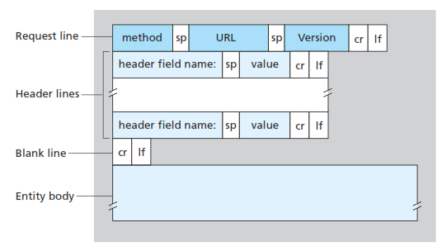
2.2. Web & HTTP
2.2.3 HTTP Message Format
General Format HTTP Request

Slide 22
2.2. Web & HTTP
2.2.3 HTTP Message Format
HTTP Response Message
It has three sections: an initial status line, six header lines, and then the entity body.
status line
(protocol
status code
status phrase)
HTTP/1.1 200 OK
Connection close
Date: Thu, 06 Aug 1998 12:00:15 GMT
Server: Apache/1.3.0 (Unix)
Last-Modified: Mon, 22 Jun 1998 …...
Content-Length: 6821
Content-Type: text/html
data data data data data ...
header
lines
data, e.g.,
requested
HTML file

Slide 23
2.2. Web & HTTP
2.2.3 HTTP Message Format
The status line has three fields: the protocol version field, a status code, and a corresponding status message.
Some common status codes and associated phrases include:
200 OK
301 Moved Permanently
400 Bad Request
404 Not Found
505 HTTP Version Not Supported

Slide 24
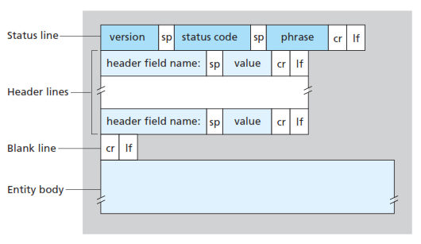
2.2. Web & HTTP
2.2.3 HTTP Message Format
General Format HTTP Response

Slide 25
2.2. Web & HTTP
2.2.4 User-Server Interaction: Cookies
Web servers that can handle thousands of simultaneous TCP connections.
However, it is often desirable for a Web site to identify users, either because the server wishes to restrict user access or because it wants to serve content as a function of the user identity.
For these purposes, HTTP uses cookies. Cookies, defined in [RFC 6265], allow sites to keep track of users.
Most major commercial Web sites use cookies today.
Notes:
It is important to note that the server sends requested files to clients without storing any state information about the client.
If a particular client asks for the same object twice in a period of a few seconds, the server does not respond by saying that it just served the object to the client; instead, the server resends the object, as it has completely forgotten what it did earlier.
Because an HTTP server maintains no information about the clients, HTTP is said to be a stateless protocol.

Slide 26
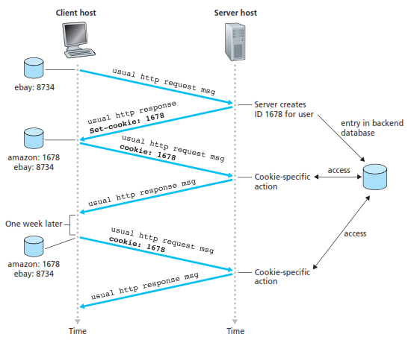
2.2. Web & HTTP
2.2.4 User-Server Interaction: Cookies

Slide 27
2.2. Web & HTTP
2.2.4 User-Server Interaction: Cookies
Many major Web sites use cookies
Four components:
1) cookie header line of HTTP response message
2) cookie header line in HTTP request message
3) cookie file kept on user’s host, managed by user’s browser
back-end database at Web site
when initial HTTP requests arrives at site, site creates: unique ID and entry in backend database for ID.
What cookies can bring:
authorization, shopping carts, recommendations, and user session state (Web e-mail)

Slide 28
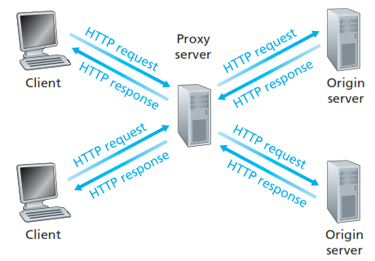
2.2. Web & HTTP
2.2.5 Web Caching
A Web cache—also called a proxy server
is a network entity that satisfies HTTP requests on the behalf of an origin Web server.
browser sends all HTTP requests to cache
object in cache: cache returns object
else cache requests object from origin server, then returns object to client

Slide 29
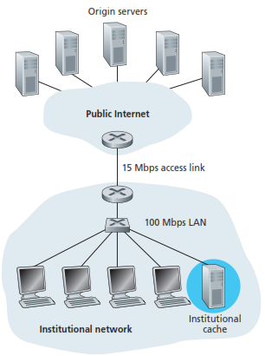
2.2. Web & HTTP
2.2.5 Web Caching
Solution :
institution must upgrade its access link from 15 Mbps to 100 Mbps.
instead installing a Web cache in the institutional network. ~But this cost is low~
Content Distribution Networks (CDNs), Web caches are increasingly playing an important role in the Internet.
A CDN company installs many geographically distributed caches throughout the Internet, thereby localizing much of the traffic.

Slide 30
Agenda
Chapter 2. Application Layer
2.1 Principle of Net Application
2.2 Web & HTTP
2.3 FTP
2.4 E-mail in The Internet
2.5 DNS
2.6 Peer-to-peer Application

Slide 31
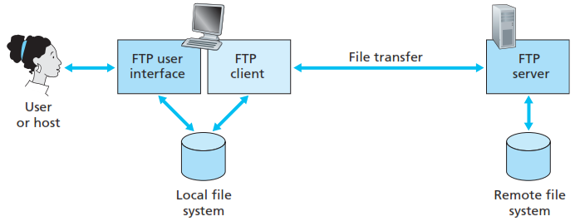
2.3. FTP
File Transfer Protocol [RFC 959],
wants to transfer files to or from a remote host.
for the user to access the remote account, the user must provide a user identification and a password.
FTP uses two parallel TCP connections to transfer a file,
a control connection (:21) and,
a data connection (:20).

Slide 32
2.3. FTP
FTP Commands and Replies
from server to client, are sent across the control connection in 7-bit ASCII format.
USER username: user identification to the server.
PASS password: user password to the server.
LIST: to ask the server to send back a list of all the files
RETR filename: Used to retrieve (that is, get) a file
STOR filename: Used to store (that is, put) a file
Some typical replies, along with their possible messages, are as follows:
331 Username OK, password required
125 Data connection already open; transfer starting
425 Can’t open data connection
452 Error writing file

Slide 33
Agenda
Chapter 2. Application Layer
2.1 Principle of Net Application
2.2 Web & HTTP
2.3 FTP
2.4 E-mail in The Internet
2.5 DNS
2.6 Peer-to-peer Application

Slide 34
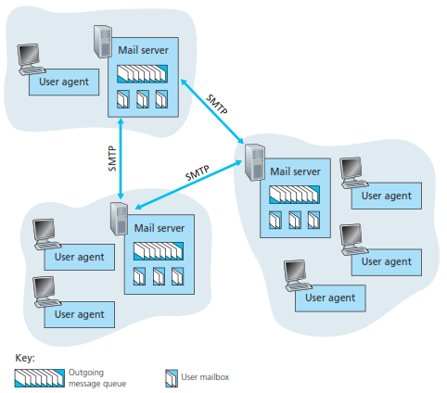
2.4. E-Mail
Three major components:
user agents
mail servers
simple mail transfer protocol: SMTP
User Agent
a.k.a. “mail reader”
composing, editing, reading mail messages
e.g., Eudora, Outlook, elm, Mozilla Thunderbird
outgoing, incoming messages stored on server

Slide 35
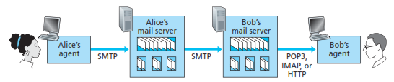
2.4. E-Mail
SMTP | POP3 | IMAP
SMTP uses persistent connections SMTP in RFC 5321 SMTP requires message (header & body) to be in 7-bit ASCII SMTP server uses CRLF.CRLF to determine end of message | POP3 is stateless across sessions Post Office Protocol [RFC 1939] authorization (agent <-->server) and download | Internet Mail Access Protocol [RFC 1730] more features (more complex) manipulation of stored msgs on server (Allows user to organize messages in folders)

Slide 36
Comparison HTTP and Email
 | HTTP | eMail
Protocol Category | Pull Protocol | Push Protocol
Message Format | 7-bit ASCII (Header & Body) | Free (no Restriction)
Document Handling | how a document consisting of text and Images | encapsulates each object in its own HTTP response message
Notes:
See on… Page 151 Kurose 6 Ed.

Slide 37
Agenda
Chapter 2. Application Layer
2.1 Principle of Net Application
2.2 Web & HTTP
2.3 FTP
2.4 E-mail in The Internet
2.5 DNS
2.6 Peer-to-peer Application

Slide 38
2.5. DNS
People: many identifiers: SSN, name, passport #
Internet hosts, routers:
IP address (32 bit) - used for addressing datagrams
“name”, e.g., www.telkomuniversity.com - used by humans
The DNS servers are often UNIX machines running the Berkeley Internet Name Domain (BIND) software [BIND 2012].
DNS is defined in RFCs 1034, 1035, 2181, and further elaborated in many others.
For the Internet, the top of the naming hierarchy is managed by an organization called ICANN (Internet Corporation for Assigned Names and Numbers).
Notes:
An IP address is hierarchical because as we scan the address from left to right, we obtain more and more specific information about where the host is located in the Internet (that is, within which network, in the network of networks).
Similarly, when we scan a postal address from bottom to top, we obtain more and more specific information about where the addressee is located.

Slide 39
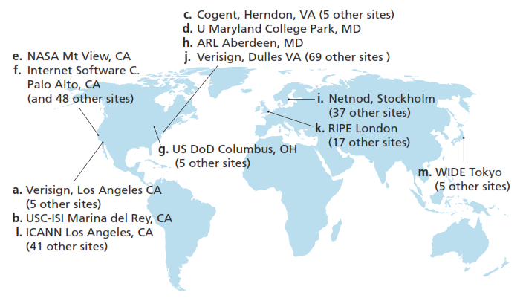
DNS root servers in 2012
(name, organization, location)

Slide 40
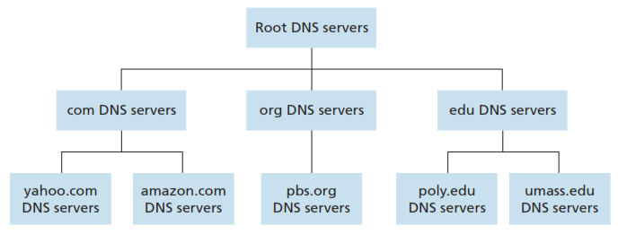
2.5. DNS ^{James F. Kurose}
The DNS is… [KUR]
a distributed database implemented in a hierarchy of DNS servers, and
an application-layer protocol that allows hosts to query the distributed database.
Notes:
An IP address is hierarchical because as we scan the address from left to right, we obtain more and more specific information about where the host is located in the Internet (that is, within which network, in the network of networks).
Similarly, when we scan a postal address from bottom to top, we obtain more and more specific information about where the addressee is located.

Slide 41
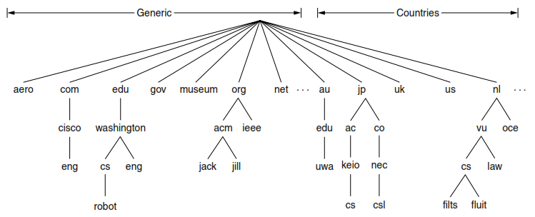
2.5. DNS ^{Andrew S. Tanenbaum}
The essence of DNS is… [TAN]
the invention of a hierarchical,
domain-based naming scheme and
a distributed database system for implementing this naming scheme.
Notes:
An IP address is hierarchical because as we scan the address from left to right, we obtain more and more specific information about where the host is located in the Internet (that is, within which network, in the network of networks).
Similarly, when we scan a postal address from bottom to top, we obtain more and more specific information about where the addressee is located.

Slide 42
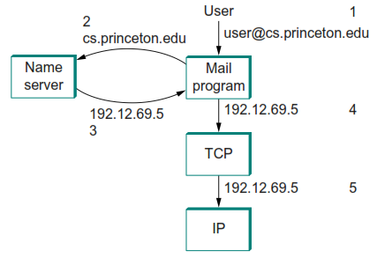
2.5. DNS ^{Larry L. Peterson}
DNS employs a hierarchical namespace rather than a ﬂat name space, and the “table” of bindings that implements this name space is partitioned into disjoint pieces and distributed throughout the Internet. [PET]
Note : that the Internet did not always use DNS.
Notes:
An IP address is hierarchical because as we scan the address from left to right, we obtain more and more specific information about where the host is located in the Internet (that is, within which network, in the network of networks).
Similarly, when we scan a postal address from bottom to top, we obtain more and more specific information about where the addressee is located.

Slide 43
Bonus
Question : [to be written, one week, no plagiarism]
Consider a situation in which a cyberterrorist makes all the DNS servers in the world crash simultaneously. How does this change one’s ability to use the Internet?
DNS uses UDP instead of TCP. If a DNS packet is lost, there is no automatic recovery. Does this cause a problem, and if so, how is it solved?
Can a machine with a single DNS name have multiple IP addresses? How could this occur?

Slide 44
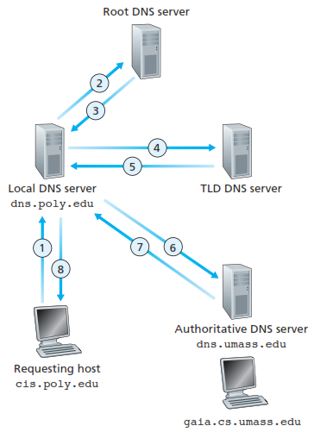
Explain details this picture! (In Bahasa Indonesia)

Slide 45
Agenda
Chapter 2. Application Layer
2.1 Principle of Net Application
2.2 Web & HTTP
2.3 FTP
2.4 E-mail in The Internet
2.5 DNS
2.6 Peer-to-peer Application

Slide 46
2.6. Peer-to-Peer Applications
There is minimal (or no) reliance on always-on infrastructure servers.
Instead, pairs of intermittently connected hosts, called peers, communicate directly with each other.
two different applications that well-suited for P2P designs.
The first is file distribution, where the application distributes a file from a single source to a large number of peers. File distribution is a nice place to start our investigation of P2P.
The second P2P application we’ll examine is a database distributed over a large community of peers. For this application, we’ll explore the concept of a Distributed Hash Table (DHT).

Slide 47
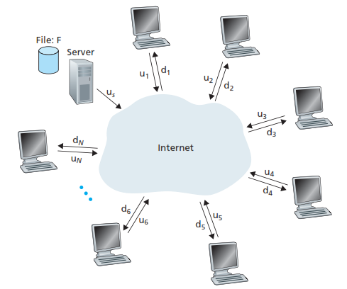
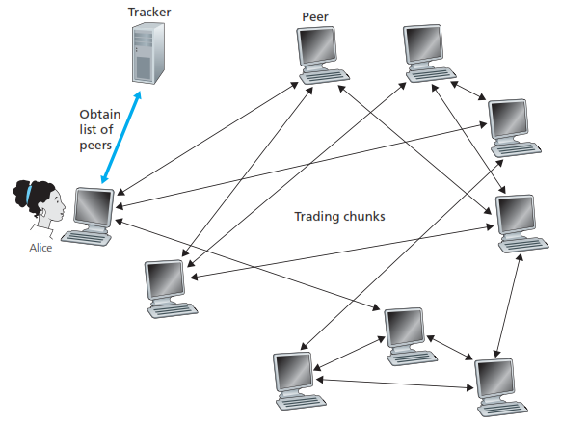
2.6.1 P2P File Distribution
The file might be a new version of the Linux operating system, a software patch for an existing operating system or application, an MP3 music file, or an MPEG video file.
In client-server file distribution, the server must send a copy of the file to each of the peers—placing an enormous burden on the server and consuming a large amount of server bandwidth.
In P2P file distribution, each peer can redistribute any portion of the file it has received to any other peers,
Notes:
Ex: bit torrent

Slide 48
2.6.1 P2P File Distribution
describing a centralized version of this simple database, which will simply contain (key, value) pairs.
the keys could be content names (e.g., names of movies, albums, and software), and the value could be the IP address at which the content is stored; in this case, an example key-value pair is.
We query the database with a key. If there are one or more key-value pairs in the database that match the query key, the database returns the corresponding values.
So, for example, if the database stores social security numbers and their corresponding human names, we can query with a specific social security number, and the database returns the name of the human who has that social security number.
Or, if the database stores content names and their corresponding IP addresses, we can query with a specific content name, and the database returns the IP addresses that store the specific content.
Notes:
Ex: bit torrent

Slide 49
Bibliography
Kurose, J.F., and Ross, K.W., Computer Networking : A Top-Down Approach Sixth Edition, Pearson Education, Inc. USA, 2013.
Peterson, L.L., and Davie, B.S., Computer Networks: A Systems Approach Fifth Edition, Morgan Kaufmann, Burlington USA, 2012.
Tanenbaum, A.S., and Wetherall, D.J., Computer Networks Fifth Edition, Pearson Education, Inc., Boston USA, 2011.
Lammle T., Cisco Certified Network Associate : Study Guide Fifth Edition, Sybex, Inc. USA, 2005.

Slide 50
Thank You
Gandeva Bayu Satrya (GBS)
gandeva.bayu.s@gmail.com
TELKOM INSTITUTE of TECHNOLOGY

